Slide 1
ARM – Cortex microcontrollers
SENSOR SYSTEMS
Dr. Federica Villa

Slide 2
Summary
ARM-Cortex cores
Exceptions, Interrupts, and Faults
STM32 microcontroller
NUCLEO board
POLIMI expansion board
Beep: 05 – C-programming

Slide 3
Summary
ARM-Cortex cores
Exceptions, Interrupts, and Faults
STM32 microcontroller
NUCLEO board
POLIMI expansion board

Slide 4
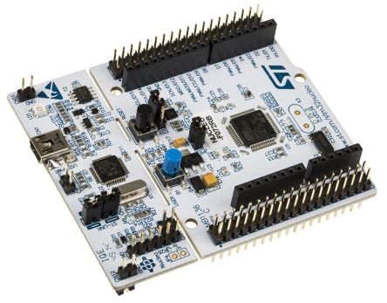
Embedded systems definition
An embedded system is a microprocessor-based computer hardware system with software that is designed to perform a dedicated function, either as an independent system or as a part of a large system.
Limited resources:
Processing
Memory
Peripherals
Notes:
Examples of high-end ES are mobile phones and any other smart electronic equipment containing a programmed uC to perform tasks.

Slide 5
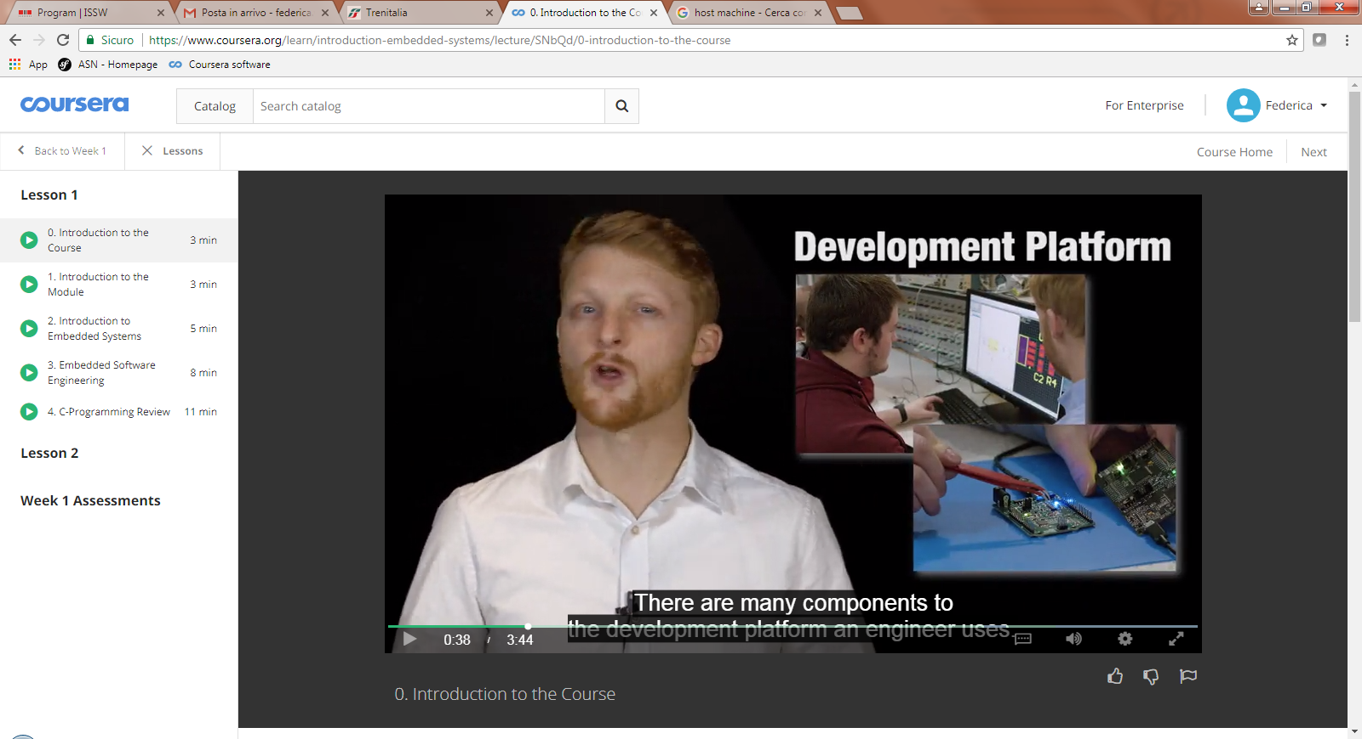
Development platform
Platform components:
host machine:
development environment
compiler toolchain
version control
development kit
Notes:
You must start with the environment you design in or the development platform. There are many components to the development platform an engineer uses.
Building experience with this platform will allow you to go about developing software for a variety of embedded systems quickly, efficiently and optimized.
The development platform components include a host machine, a development environment to write and test code in. A compiler toolchain to generate designs, development kits to integrate with, and version control to track software history. A software engineer interacts with all of these components usually on a daily basis. With in-depth practice and conceptual understanding of utilizing our embedded systems development environment. You can easily set up, apply tools and start coding for many embedded platforms.

Slide 6
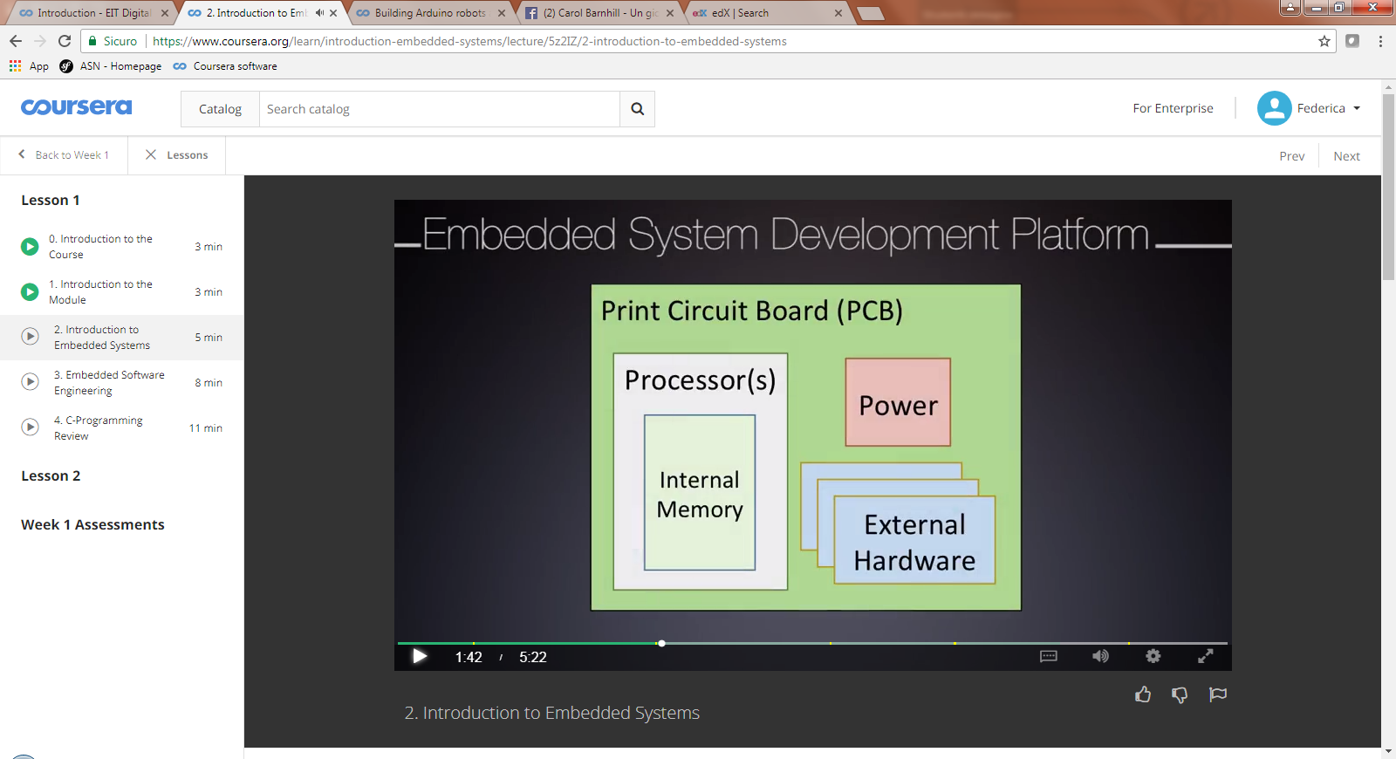
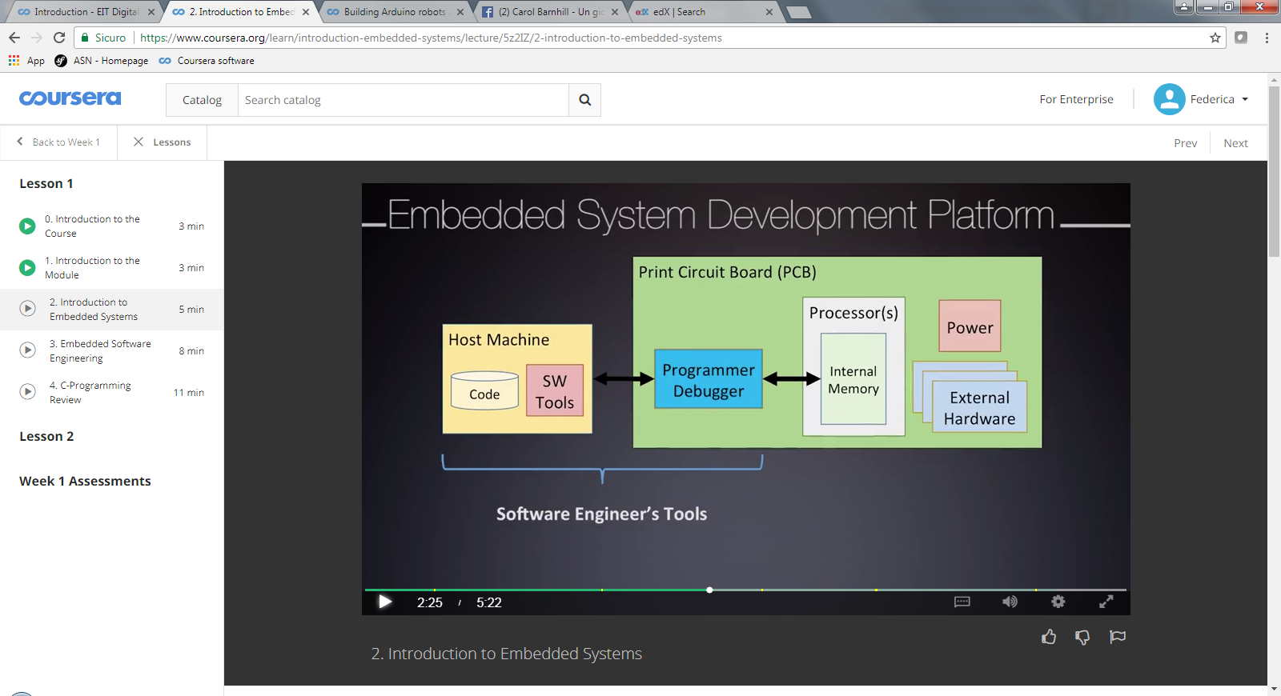
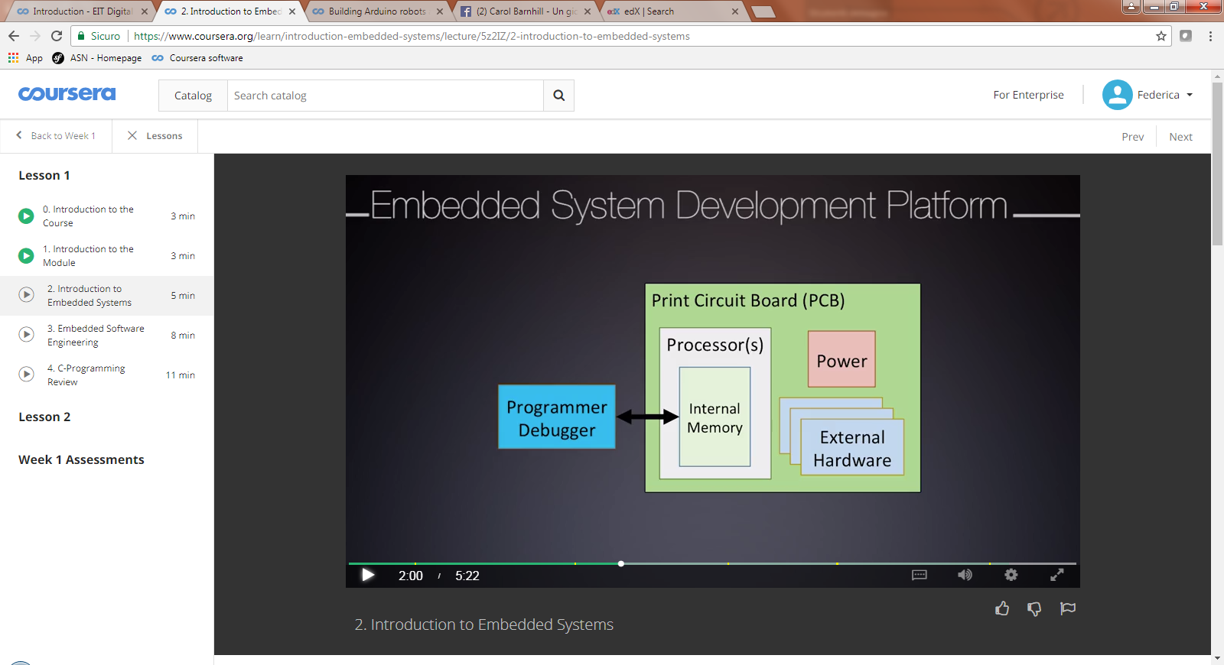
Development platform
Software engineer’s
tools
Hardware
(end-user)
Notes:
The target embedded system will likely use printed circuit board technology, or PCBs. It interconnects many integrated circuits and passive developments that all have been soldered on to the board. This includes your processor and your power converters.
External programmers are connected to the embedded systems processor, in order to install a target application into the internal memory. Modern designs have begun to integrate extra onboard programmer debugger hardware to simplify this process.
A host machine is responsible for developing and compiling and coordinate the install which is equally as important as development of the PCB itself. The host machine is where your software files live.

Slide 7
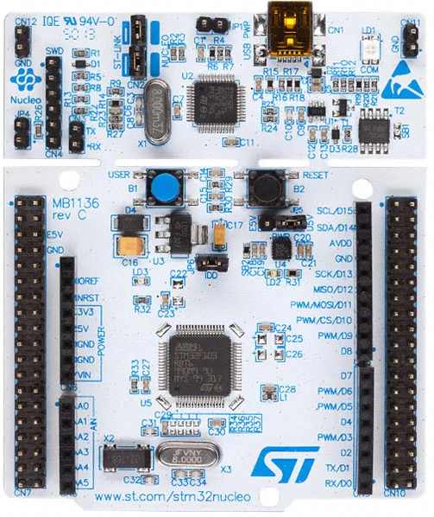
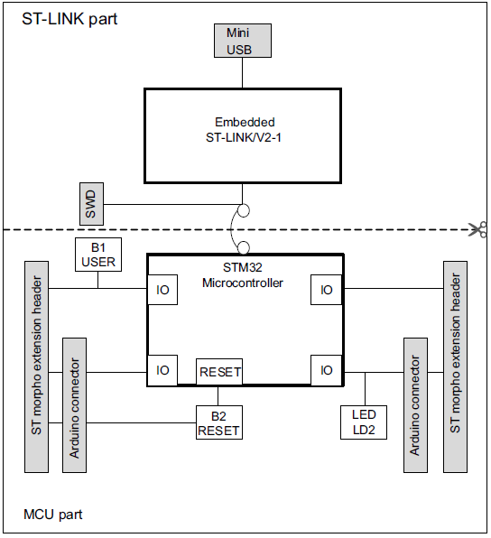
Example of a development platform

Slide 8
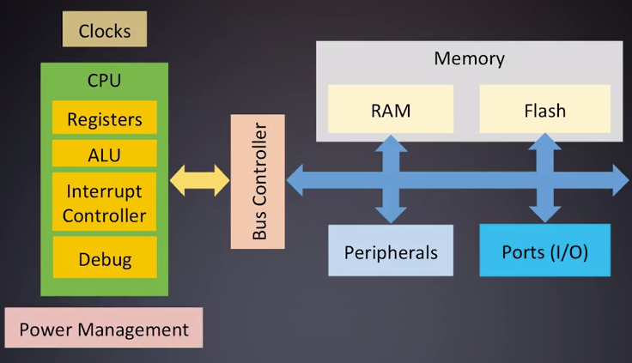
Microcontroller definition
A microcontroller is a microprocessor with added functionality such as memory and peripheral hardware.
Notes:
The processor of the microcontroller is called the CPU or the Central Processing Unit. This is a piece of hardware that runs our software by fetching and executing assembling instructions from memory.
This instructions perform mathologic operations as well as coordinating data movement. CPU has many sub components with many responsibilities. Many registers general purpose and special purpose.
Store operations data and systems state. An Arithmetic Logic Unit (ALU), performs the fundamental low level assembly operations, an Interrupt Controller coordinates a synchronize events requests of the processor. Lastly, eventually a Debug interface is used to help troubleshoot and store programs.

Slide 9
Microcontroller peripherals
Communication:
I2C
UART
SPI
Ethernet
CAN
USB
Timing
clock generator
timers
counters
Pulse Width Modulators (PWM)
Watchdog
Analog signal processing:
ADC
DAC
voltage reference
analog comparators
analog sensors
Input / Output
Power control circuits
…

Slide 10
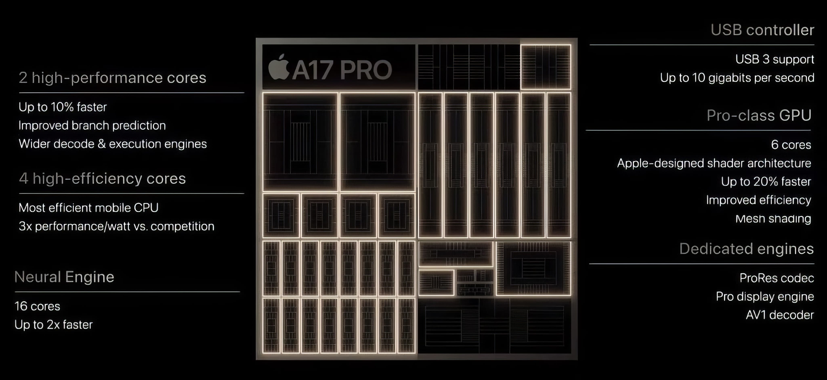
A17 Pro

Slide 11

















Why ARM?
Arm Holdings provides the I.P. for the core processor
ARM – Cortex → 32 bit registers

Slide 12
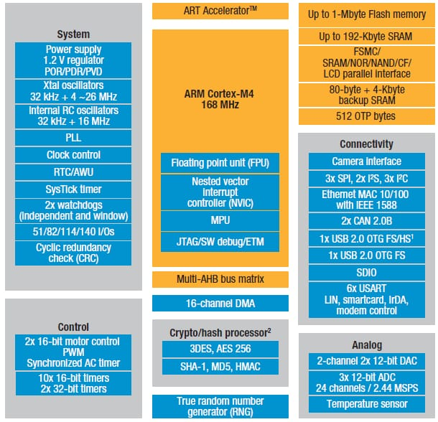
STM32F4 Block diagram

Slide 13
RISC vs CISC
ARM = Advanced RISC Machine
Reduced Instruction Set Computer
(Very simple instructions that execute within a single cycle, at high clock speed)
vs
CISC = Complex Instruction Set Computer
(more complex instructions to complete a task in as few lines as possible)
Notes:
In contrast with CISC (complex instruction set computer), over which are based intel and AMD microcontrollers

Slide 14
RISC vs CISC: an example
Pick the ball command to a pet
CISC:
Pick the ball
RISC:
Track the toy
Pick the toy up
Get back to the owner
Hamd over the toy to the owner
How to execute 1800 + 1801
CISC:
ADD 1800, 1801
RISC:
Load X, 1800
Load Y, 1801
ADD X, Y
Store 1800, X
Memory locations

Slide 15
RISC vs CISC
Cisc
- Little work from the compiler to pass from high-level language into assembly (and few memory needed)
- Short codes
- More clock cycles
- Pipeline more difficult
- More transistors used to store instructions
Risc
- Long codes and more RAM needed (and it must also be fast)
- More general purpose hardware
- One cycle per instruction (or even less)
- Pipeline easier
- More transistors used for register memories

Slide 16
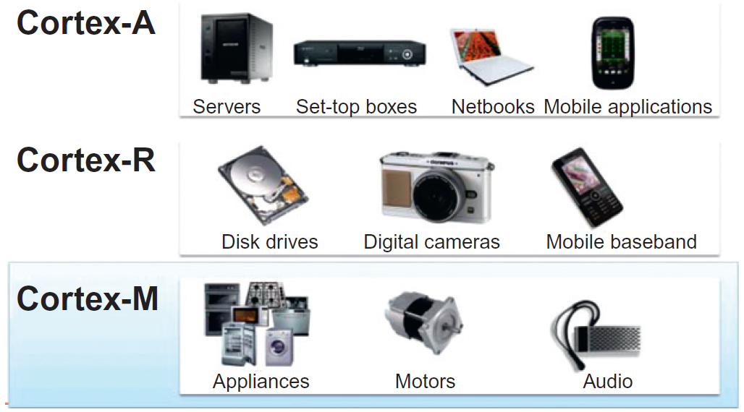
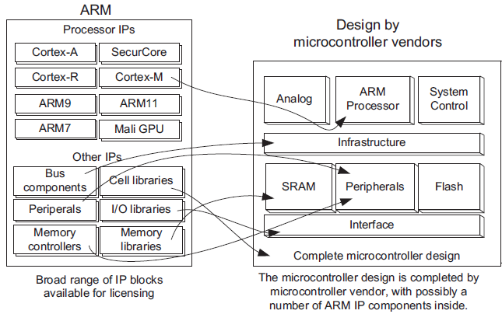
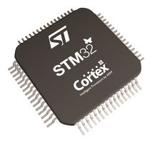
ARM-Cortex families
Different «profiles»
- A: application (high-end)
- R: real time (more focus
on timing performance)
- M: more wide-range and
mainstream
Business model:
Intellectual
Property
Licensing

Slide 17
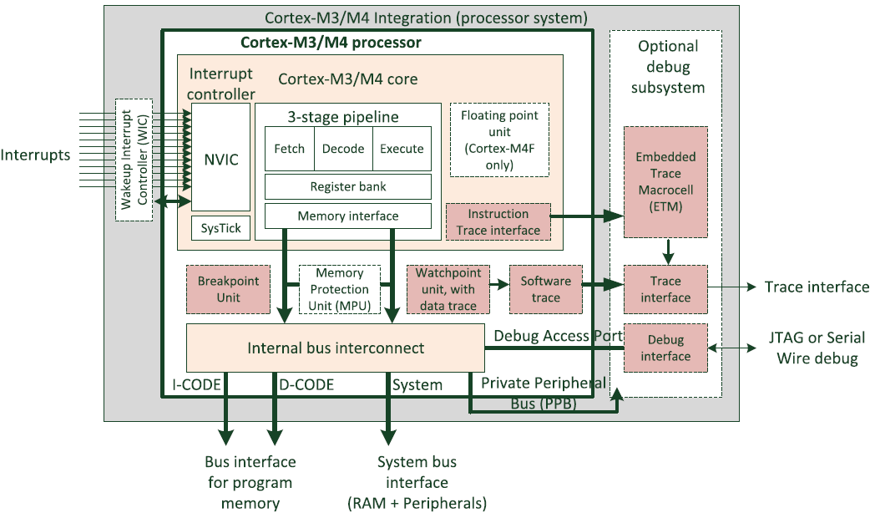
ARM-Cortex M3 and M4 architectures
Notes:
NVIC = Nested Vector Interrupt Controller

Slide 18
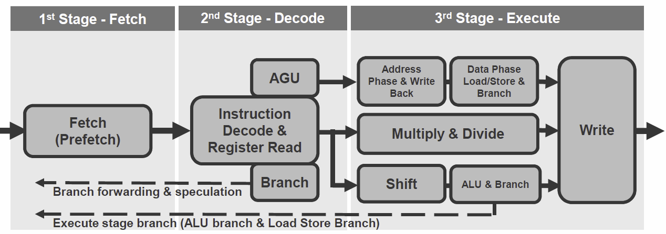
ARM-Cortex pipelining
2-level (M0+)
3-level (M3/4)
Notes:
AGU = address generation unit

Slide 19
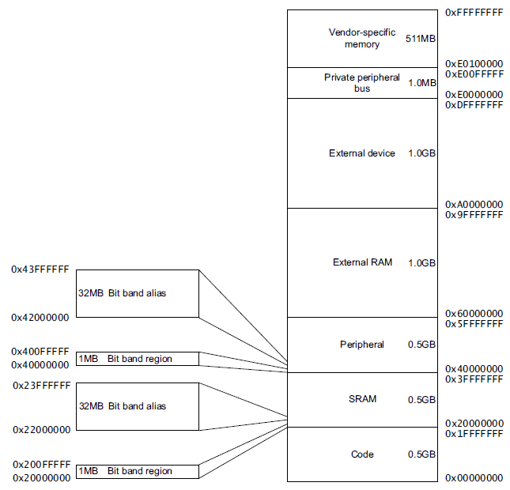
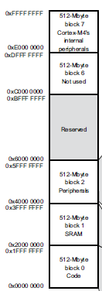
ARM-Cortex M4 memory map
4 GB addressable memory

Slide 20
Summary
ARM-Cortex cores
Exceptions, Interrupts, and Faults
STM32 microcontroller
NUCLEO board
POLIMI expansion board

Slide 21
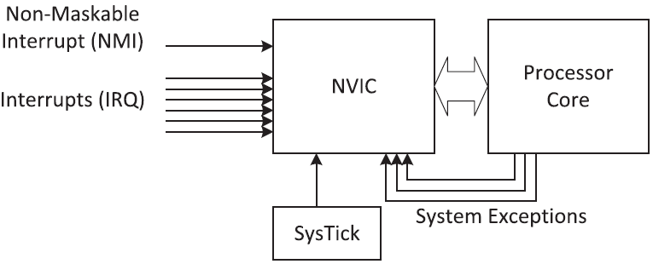
ARM-Cortex M4 exceptions and interrupts
Nested Vectored Interrupt Controller (NVIC)
Exception sources:
Reset invoked on power up or warm reset, stops processor; restart is privileged Thread mode execution.
NMI interrupt by a peripheral or by software, highest priority exception other than reset; permanently enabled.
HardFault occurs because of an error during exception processing.
MemManage because of a memory protection related fault, for both instruction and data transactions.
BusFault because of a memory related fault for instruction or data transaction, e.g. error detected on a memory bus.
UsageFault related to instruction faults, such as: undefined instruction; illegal unaligned access; division by zero; etc..
SVCall SuperVisor Call triggered by the SVC instruction (e.g. to access OS kernel functions and device drivers).
PendSV interrupt-driven request for system-level service (e.g. used in OS for context switching).
SysTick generated by the system timer when it reaches zero (e.g. used as system tick for Real-Time Clock).
Interrupt IRQ Interrupt Servicing Request signalled by a peripheral.
Notes:
NMI: non-recoverable hardware errors
IRQ = interrupt request
Manage the priority of except and interr

Slide 22
ARM-Cortex M4 interrupt vector
Exception priorities
Vector Table (start address for all exception handlers)

Slide 23
Summary
ARM-Cortex cores
Exceptions, Interrupts, and Faults
STM32 microcontroller
NUCLEO board
POLIMI expansion board

Slide 24
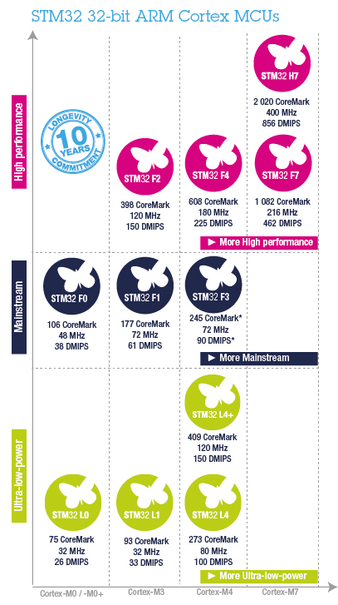
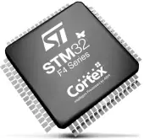
STM32 Family
STM32F4:
High performance
up to 180 MHz clock
Notes:
CoreMark = benchmark to evaluate performance of processor (iteration pes second), parallelization…
DMIPS = Dhrystone Mega Iteration Per Second

Slide 25
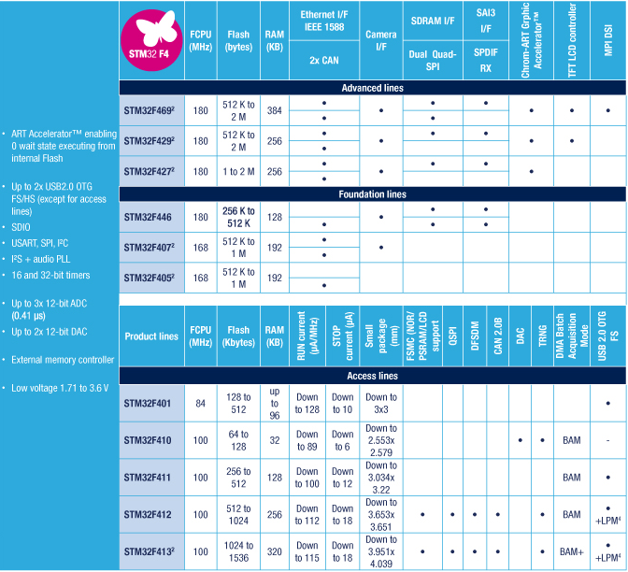
STM32F4
STM32F4xx:
Cortex M4 core

Slide 26
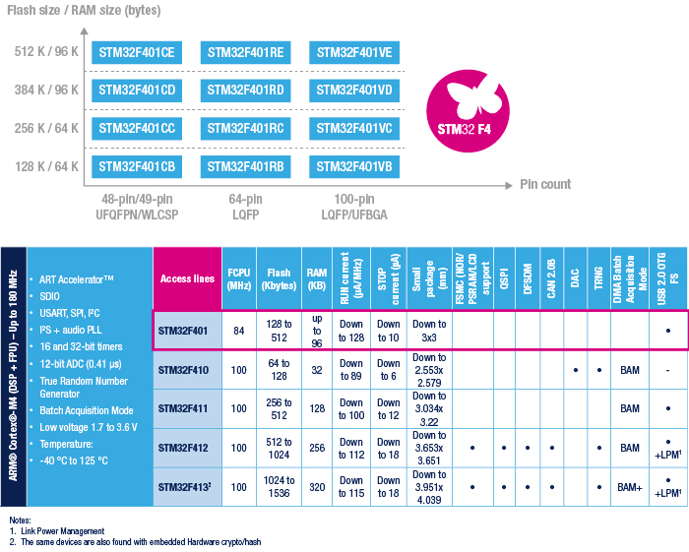
STM32F401
STM32F4xx Access line: the entry-level microcontrollers
Notes:
FSMC = flexible static memory controller
QSPI = fast SPI for image data
DFSDM = digital filters for sigma delta modulators
TRNG = true random number generator
OTG = On the Go

Slide 27
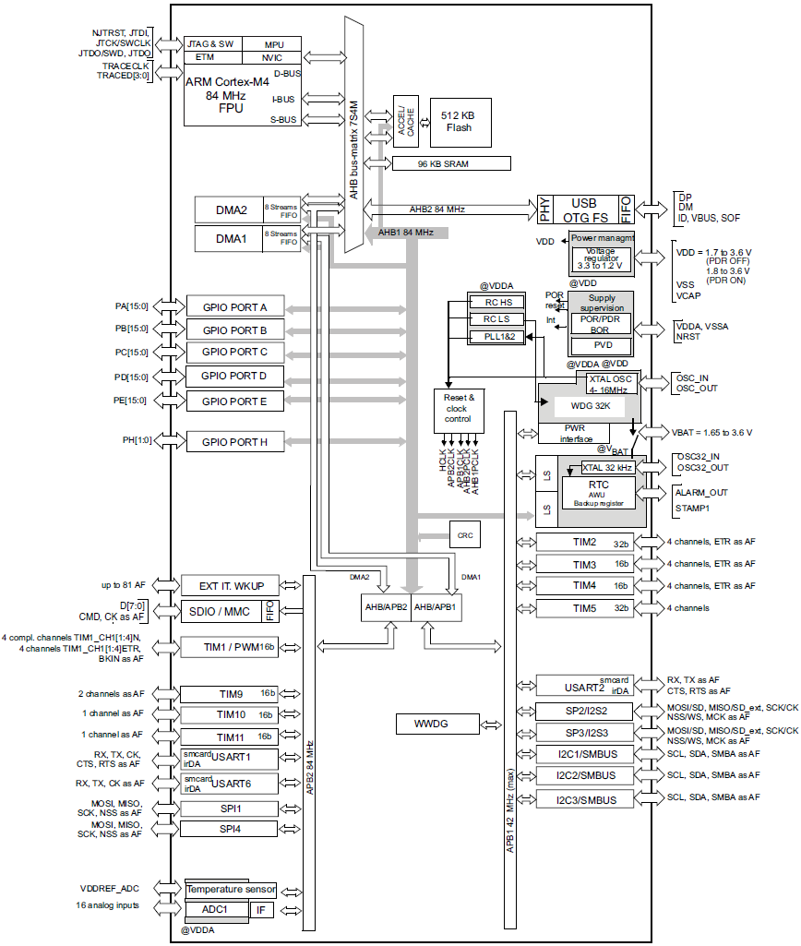

STM32F401RE
STM32F401
Notes:
AHB Advanced High-Perfromance Bus
APB Advanced Pheripheral Bus

Slide 28
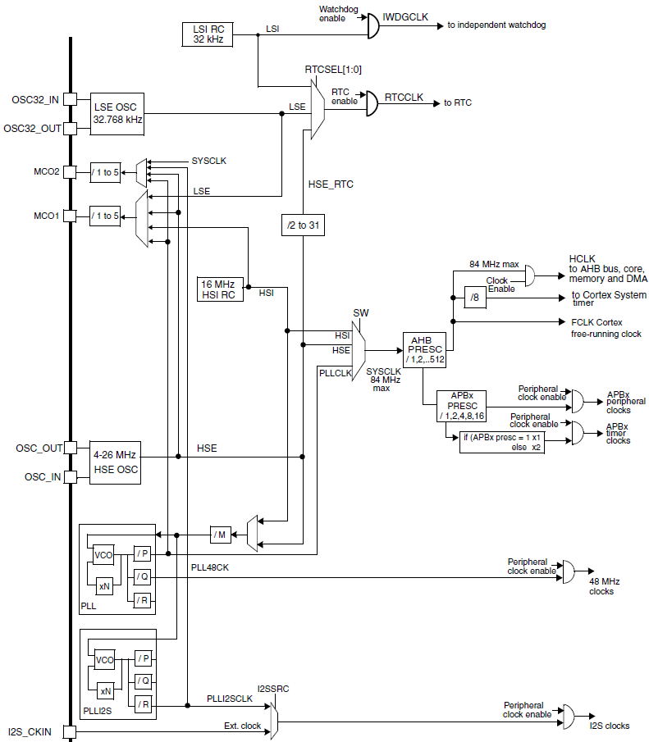
Clocks
3 clock sources for system clock (SYSCLK):
HSI oscillator clock
HSE oscillator clock
main PLL clock.
2 secondary clock sources:
a 32 kHz low-speed internal RC (LSI RC)
a 32.768 kHz low-speed external crystal (LSE crystal)
Each source can be switched on/off independently when not used
Notes:
HSI = high speed internal
HSE = high speed external
LS → used for Real Time Clock, and watchdog

Slide 29
Timer modules
Timer modules include:
reference clock (internal or external)
prescaler (reduce the clock frequency)
counter
comparison registers
Timer modules are used for:
generating interrupts
generating pulse trains
driving Pulse Width Modulation (PWM) outputs
measuring pulse length of input signals
counting events

Slide 30
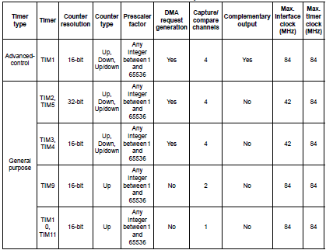
Timers feature
Notes:
Advanced timer is the only one with complementary output, useful for driving motors

Slide 31
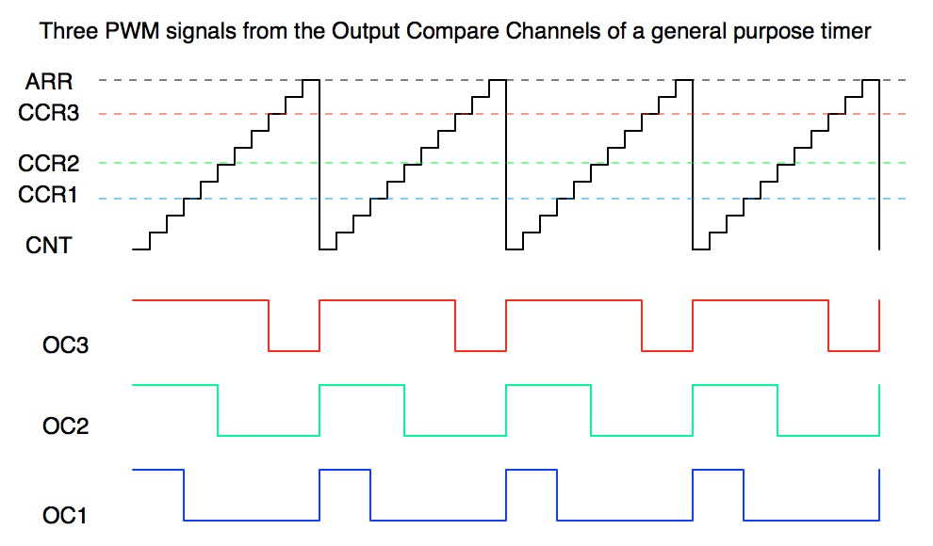
PWM generation
counters can operate in Up, Down or Up/Down mode
Notes:
ARR = Auto Relaod Register
CCR = Capture and Compare Register
CNT = Counter

Slide 32
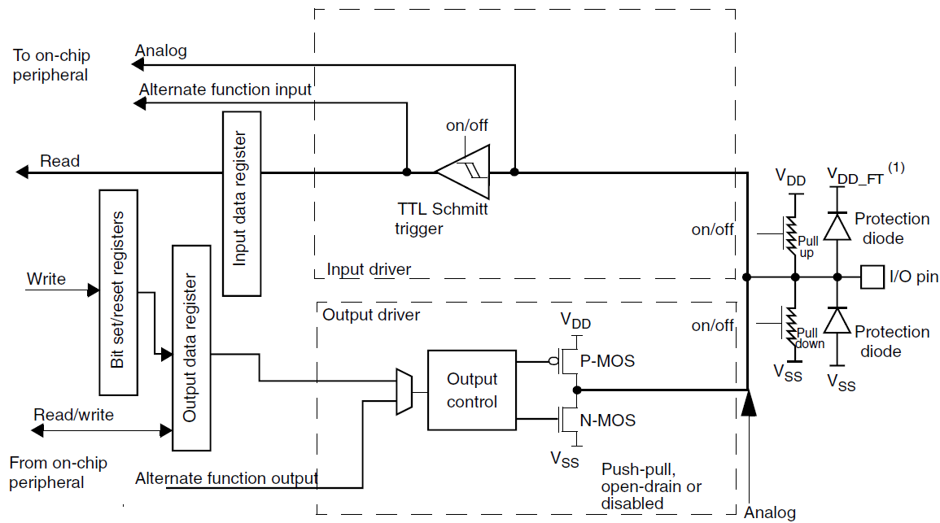
General Purpose Input/Outputs
(digital buffer)
GPIO:
6 ports (A…E, H)
each port 16 PIN
Notes:
Port FG does not exist in STM32F401
Each pin can be used as an output (and the working part is the output driver) or as an input (and the working part is the input driver), and the decision whether the port will be IN, OUT or I/O will be left to us. In case we want to use it as an I/O, it will be up to the micro/the sensor tell the port the mode in which we want the port to operate.
PERò NON MI è ANCORA CHIARO COME DIAVOLO FACCIA
Then we can also decide whether to activate the pull-up or pull-down network for that port, it is up to us.
Typically we deal with digital signals, but of course we can also have to deal with analog ones. So we also need a different path for analog signals that do not involve a digital buffer (i.e. for the ADC).
Ecco come la gestirei io:
- In this image a general purpose I/O port is represented, highlighting the most important typical parts (not all of them, this is just a schematization). You WON’T need to fully understand this image for the exam, but it helps me highlighting one, fundamental aspect of this course: everything you will use can provide a large variety of functions, and it will be up to you decide which of these functions to enable
- For example for everypin you are going to use you will have to decide whether this is an input, an output or maybe both, whether the pin will read an analog or a digital signal, whether to activate the pull-up or the pull-down network (or maybe even whether the port will be at high impedance), and so on. Everything is up to you, and you have to decide all of these aspects and we’ll see how this can be done.

Slide 33
General Purpose Input/Outputs
four 32-bit configuration registers:
GPIOx_MODER Input / Output / AF /Analog
GPIOx_OTYPER Push-pull / Open drain
GPIOx_OSPEEDR Speed
GPIOx_PUPDR Pull-up / Pull-down
two 32-bit data registers
GPIOx_IDR Input data register
GPIOx_ODR Output data register
one 32-bit set/reset register
GPIOx_BSRR
one 32-bit locking register
GPIOx_LCKR Locks the value of a GPIO until the next reset
two 32-bit alternate function (timers, comm…) selection register
GPIOx_AFRH Highest IO
GPIOx_AFRL Lowest IO

Slide 34
Alternate Functions

Slide 35
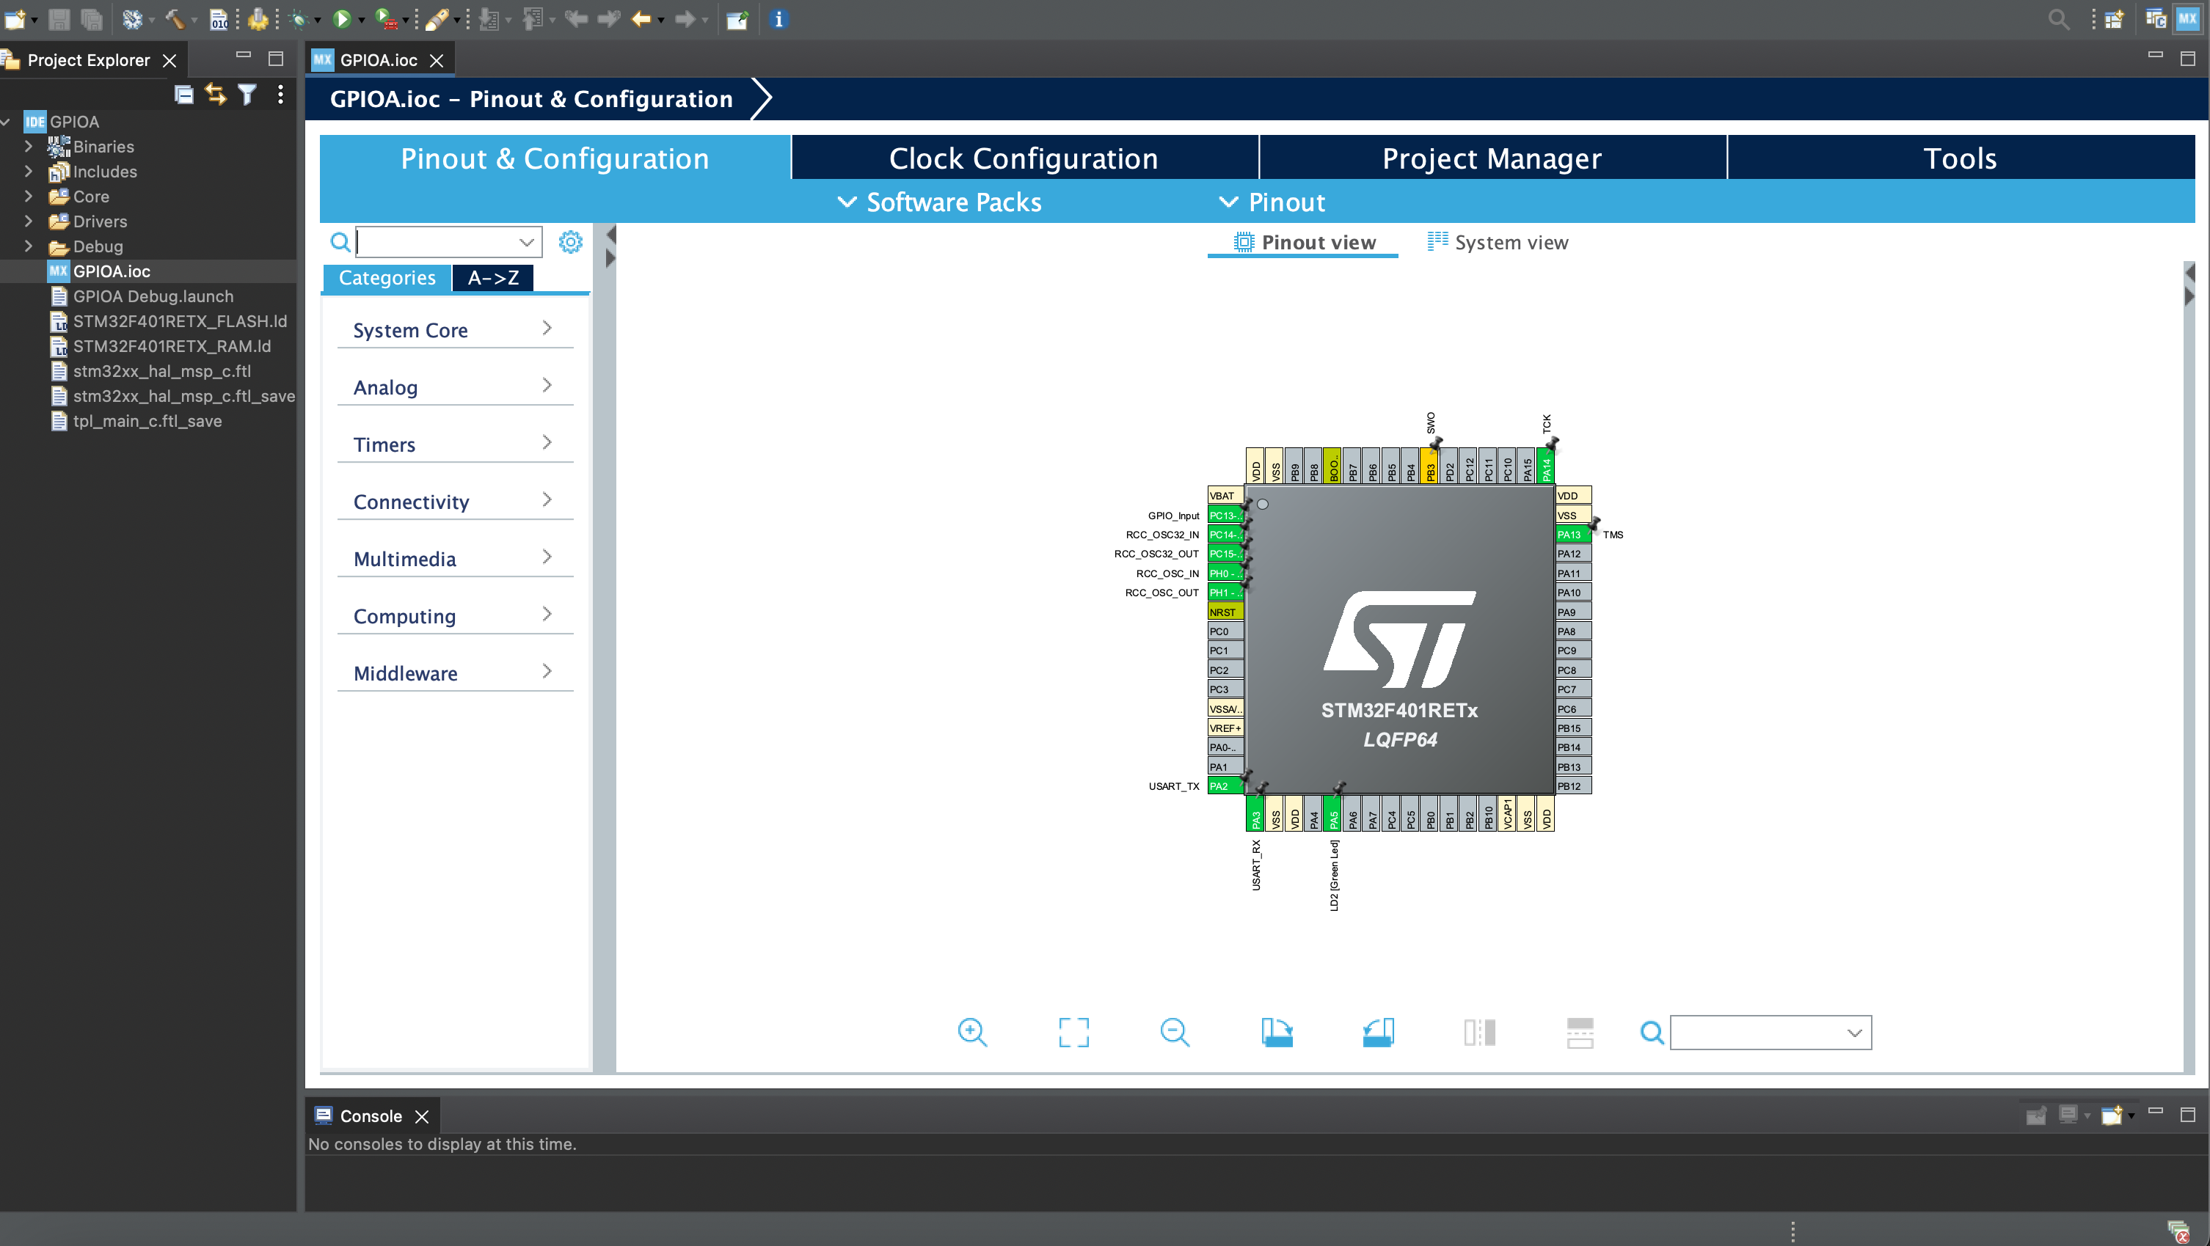
Graphical User Interface (GUI)

Slide 36
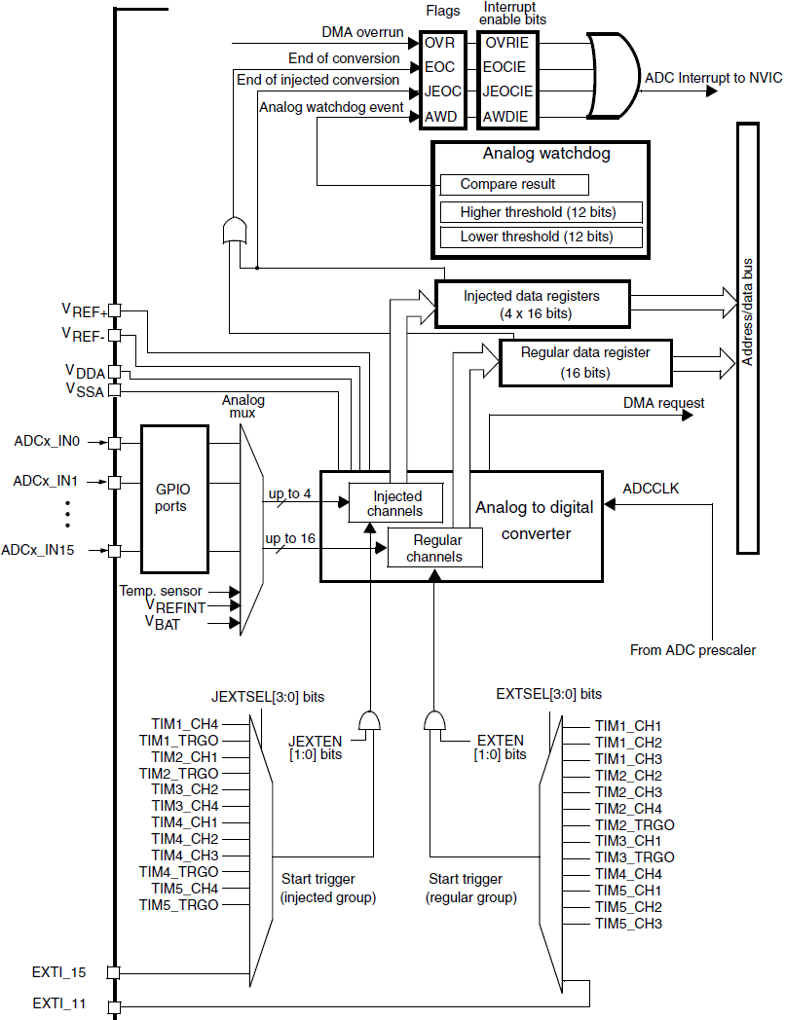
ADC
12 bit SAR
19 multiplexed channels
Many conversion modes:
single and continuous conv.
scan mode
discontinuous mode
fast-conversion mode
Internal sensors
Temperature sensor
VREFINT and VBAT
analog watchdog
Notes:
Analog watchdog allows the application to detect if input voltage goes beyond the user-defined thresholds.
Injected channels have priority on regular channels. You can configure the ADC to read in a sequence of channels in a loop. Those channels are being converted regularly. In injected mode conversion is triggered by an external event or by software. An injected conversion has higher priority in comparison to a "regular" conversion and thus interrupts the regular conversions.

Slide 37
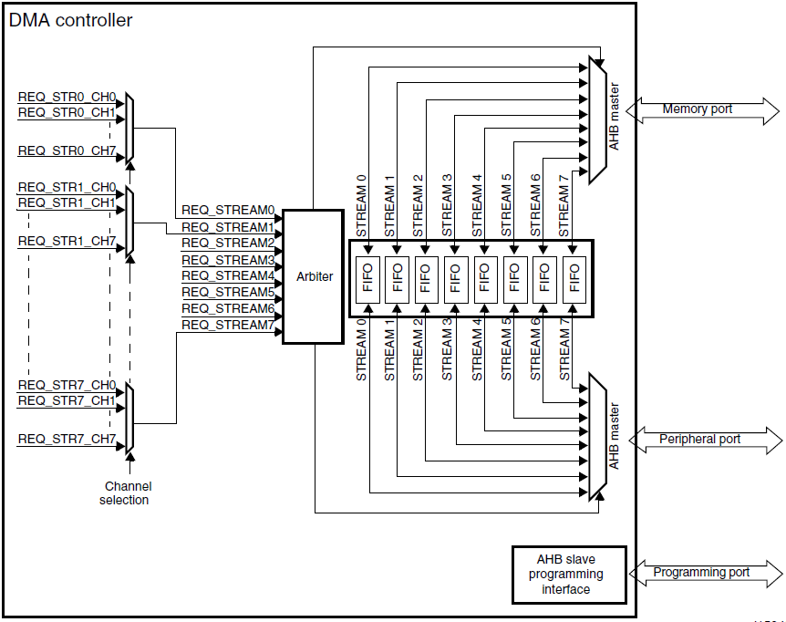
Direct Memory Access (DMA)
Provides high speed data transfer between peripherals and memory and between memory and memory.
No CPU actions, core resources free for other applications.
Notes:
An Arbiter manages the priorities.

Slide 38
Communications
I²C 2 wire synchronous communication (SCK, SDA)
3 I²C bus interfaces can operate in multi-master and slave modes.
Can support the standard (up to 100 kHz) and fast (up to 400 kHz) modes.
SPI 4 wire synchronous full-duplex communication
4 SPI interfaces
USART asynchronous single-wire half-duplex communication
3 USART interfaces

Slide 39
STM32 programming
Multiple ways to write programs for STM microcontrollers:
HAL Hardware Abstraction Layer drivers:
Hide the MCU and peripheral complexity
Maximize software portability across different microcontrollers
Exist for all peripherals
Larger overhead → performance penalty
LL Low-Level drivers:
Better optimization → improved performance
Less portability
Require deep knowledge of the MCU and peripheral specifications
Detailed description available in ST’s UM1725 User manual – NOT required for this course

Slide 40
Summary
ARM-Cortex cores
Exceptions, Interrupts, and Faults
STM32 microcontroller
NUCLEO board
POLIMI expansion board

Slide 41
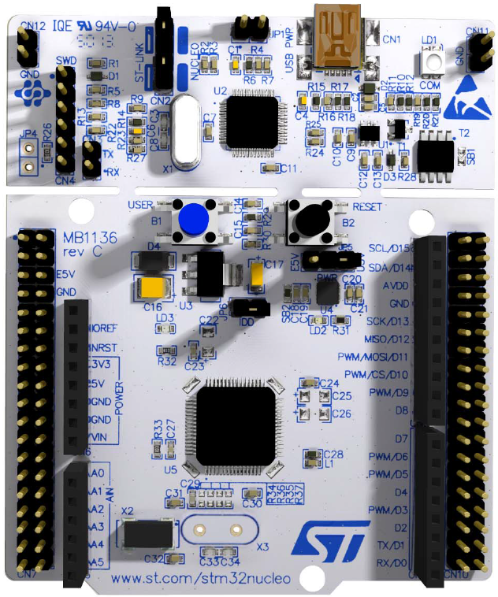
Development board
NUCLEO board
by STMicroelectronics
for STM32F family in LQFP64 package
Provided with libraries and examples.
Divided in:
microcontroller part
removable ST-LINK debugger/programmer interface
Notes:
Low Profile Quad Flat Pack

Slide 42
Nucleo board features
connector for Arduino Uno Revision 3
general purpose connector (ST morpho extension) male pin headers accessible on both side of the board full access to STM32 I/Os
3 LEDs:
LD1 (COM) for USB communication (green, red)
LD2 available for user (connected to PA5) (green)
LD3 MCU powered, +5V power is available (red)
2 pushbuttons:
B1 for USER connected to PC13
B2 for RESET
LSE (low-speed external) oscillator at 32.768 kHz
3 interfaces supported by the USB (Virtual Com port, Mass storage, Debug port)
Notes:
Connector for arduino there for compatibility with arduino uno platform, but we will not use them and remember that working with this board and with an arduino one is pretty much the same.

Slide 43
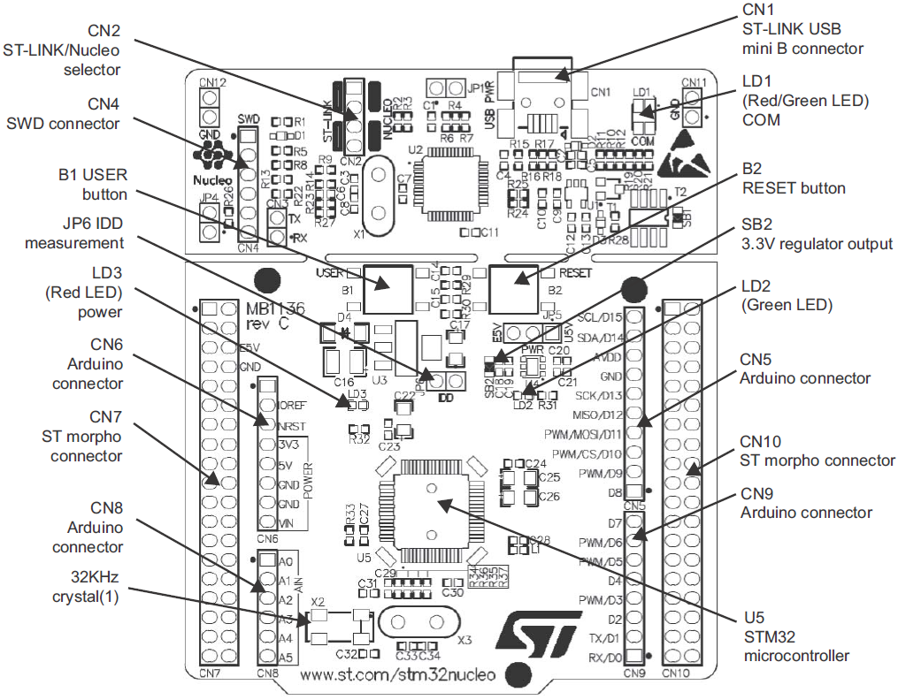
Nucleo board layout
Notes:
SWD = serial wire debug
JP6 to measure microcontroller consumption

Slide 44
Summary
ARM-Cortex cores
Exceptions, Interrupts, and Faults
STM32 microcontroller
NUCLEO board
POLIMI expansion board

Slide 45
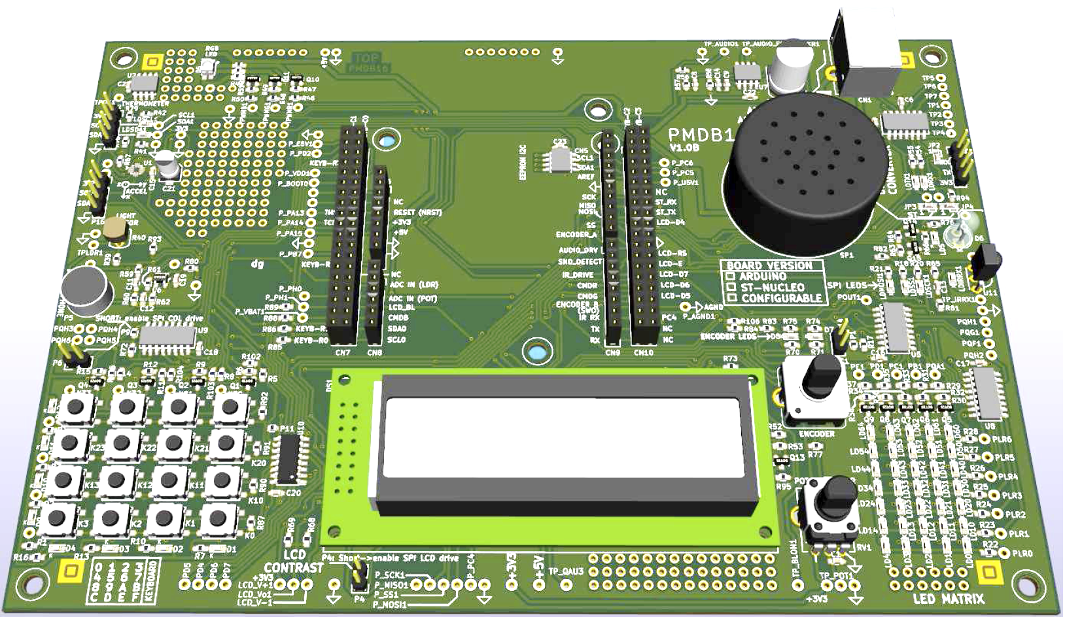
POLIMI expansion board

Slide 46
POLIMI board features
standard 16x2 LCD alphanumeric module
5x7 LEDs array area, driven by two shift registers connected to the SPI interface
4x4 keypad, connected directly to the GPIOs
incremental encoder
microphone and comparator
amplifier and speaker, connected to PWM
RGB led, connected to three PWM-configurable outputs
light sensor connected to ADC
potentiometer connected to ADC
thermometer, which communicates through I²C peripheral
accelerometer, which communicates through I²C peripheral
IR led and IR receiver
Notes:
LCD = liquid crystal display

Slide 47
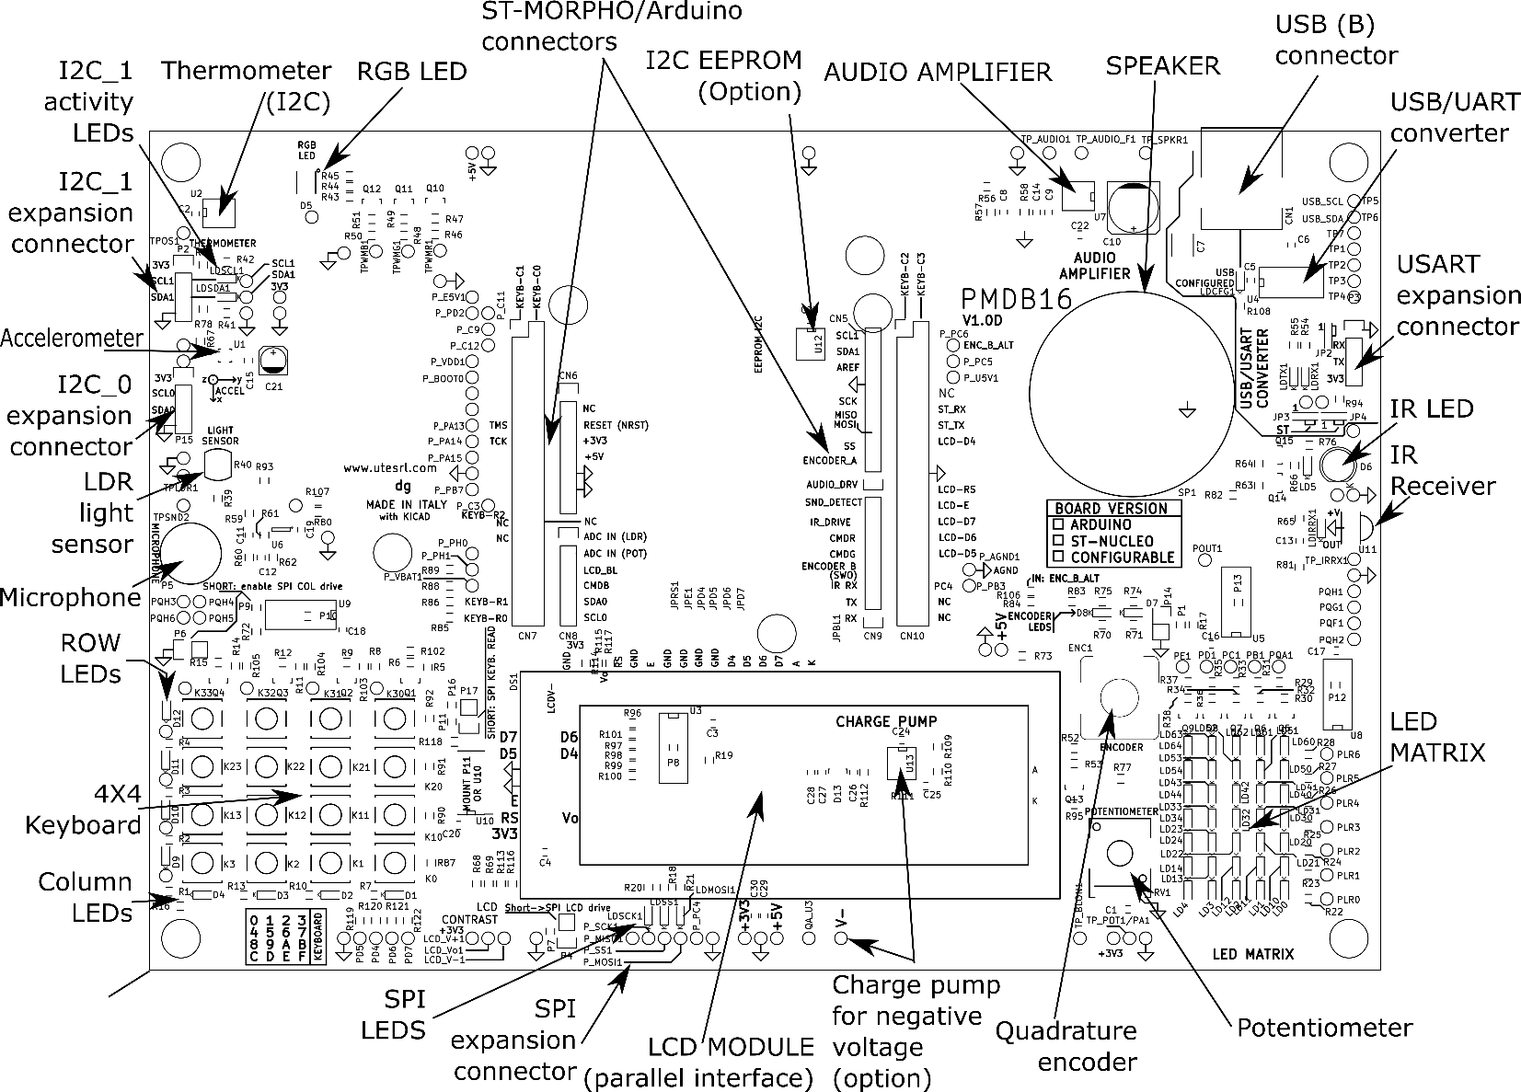
POLIMI board layout

Slide 48
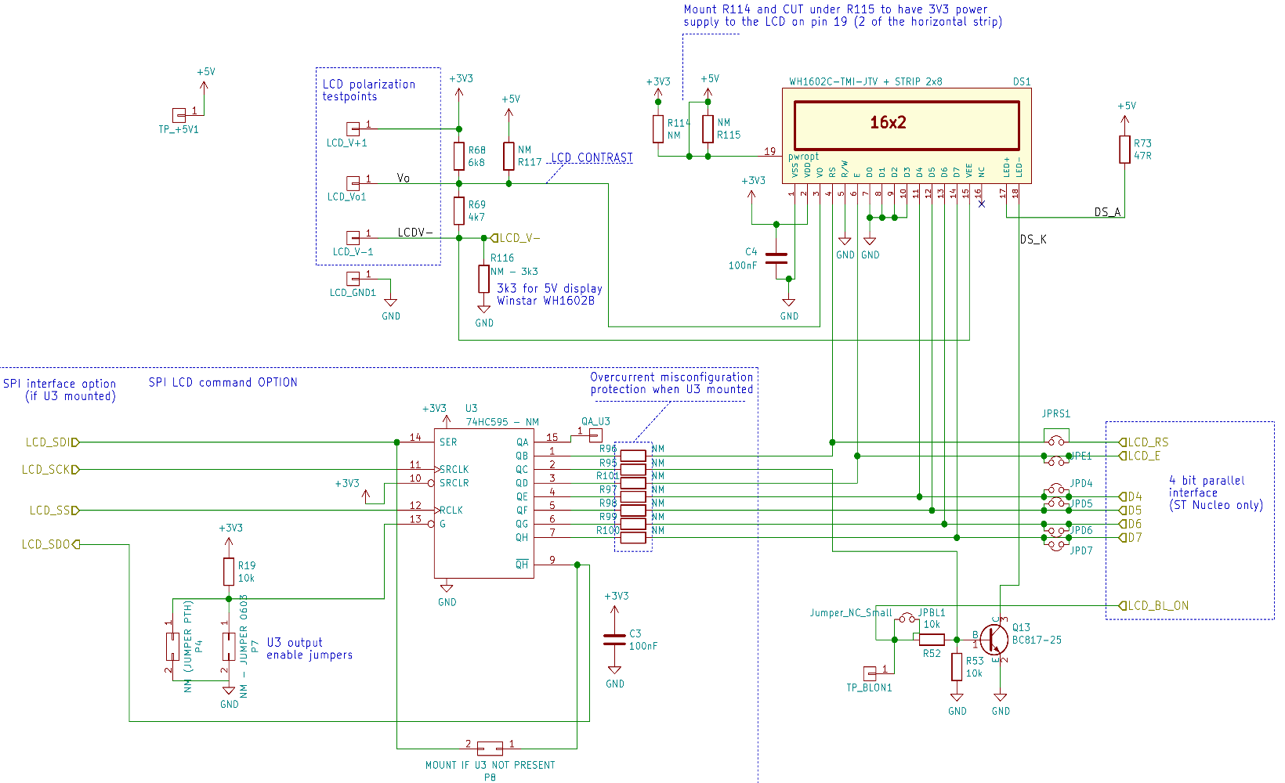
16x2 alphanumeric LCD

Slide 49
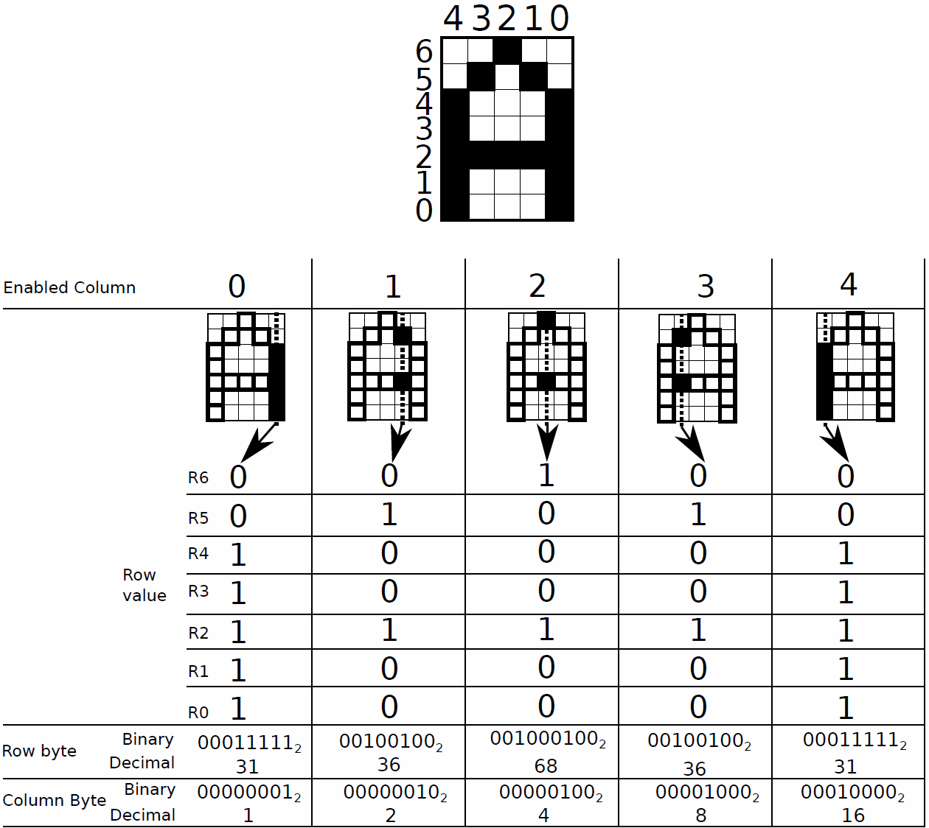
5x7 LED array
The array must be scanned enabling one column at a time (using 2 shift registers connected to the SPI).
Images on human retina persist for a time long enough so that the fast blinking of LEDs is perceived as a continuous light.

Slide 50
4x4 keypad
16 pushbutton:
lines CD0-3 are connected to STM32 outputs to enable each column
lines R0-3 are connected to STM32 inputs to read rows
R0
R1
R2
R3
4x4
pushbuttons
CD0 CD1 CD2 CD3

Slide 51
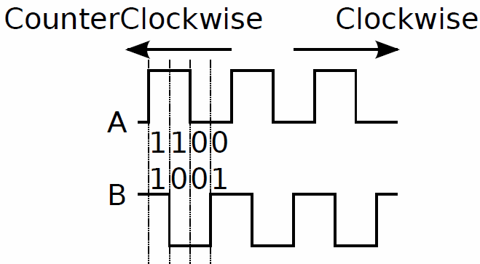
Incremental encoder
Couple of switches that change their state according to the encoder axis position.
Quadrature encoder
Channel A and B are connected to two STM32 input pin
Notes:
An incremental encoder is made of a couple of switches that change their state according to the encoder axis position. These encoders are common in motor control applications, in the old opto-mechanical mouse (the one with the rubber ball inside), and as user interfaces.

Slide 52
Microphone, amplifier and RGB LED
Microphone connected to a comparator sends asynchronous signals to the microcontroller.
This feature can be used to detect intensity peaks of a sound acquired by a microphone and to trigger an interrupt.
Audio amplifier + speaker driven by a PWM output of the microcontroller, in order to generate modulated sounds.
The input stage of this audio amplifier implements a first order low-pass filter at about 16 kHz.
RGB LED connected to 3 PWM to select the color

Slide 53
Photoresistor and Potentiometer
LDR (Light Dependent Resistor) photoresistor
Changes the voltage value of a voltage divider by varying the quantity of light reaching the sensor
Potentiometer connected as a voltage divider
→ voltage proportional to the rotation angle of the potentiometer axis.
Both are connected to an ADC channel

Slide 54
Thermometer LM75
Over-temperature shutdown
Hysteresis temperature
I²C interface

Slide 55
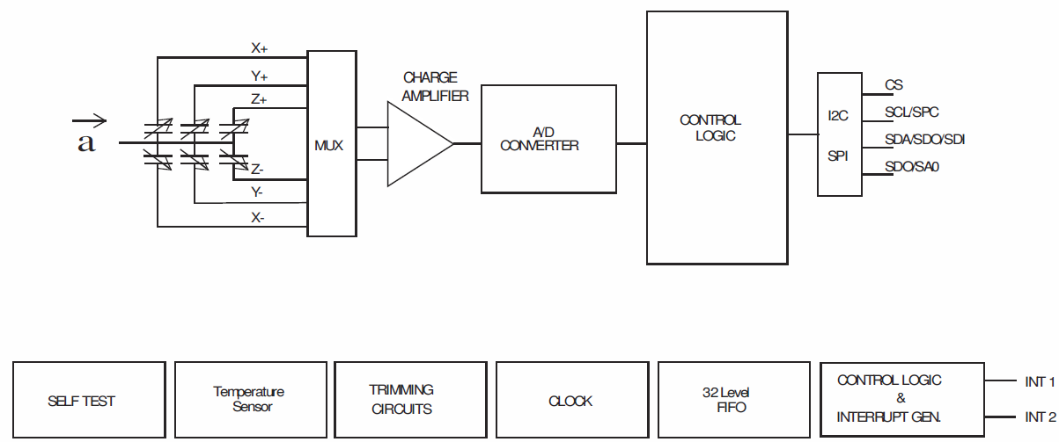
Accelerometer LIS2DE
In the POLIMI expansion board only I²C is connected

Slide 56
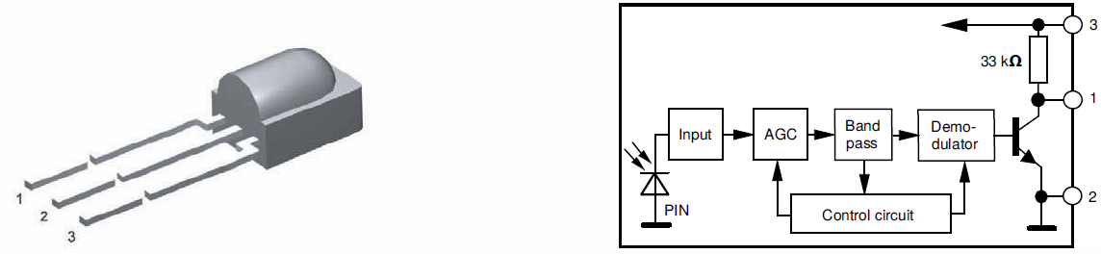
IR transmitter and IR receiver
Infrared (IR) LED (peak emission = 950 nm)
driven by a STM32 output (timer output or PWM output) Light modulated at 38 kHz.
IR Receiver (TSOP58238) based on a PIN diode
The output of the IR receiver module is connected to a STM32 input.
The output is normally high and goes low when an infrared (at 950nm wavelength) signal modulated at 38 kHz is detected.

